Slide 1
Chapter 5
- Operational Amplifiers

Slide 2
Outline
Operational amplifier (op amp)
Basic operations
DAC
Instrumentation amplifier

Slide 3
The Op Amp
Behaves like a voltage-controlled voltage source with very high amplification factor
When combined with resistors, capacitors, and inductors, can perform various functions:
  amplification/scaling
  sign changing
  addition/subtraction
  integration
  differentiation
  analog filtering

Slide 4
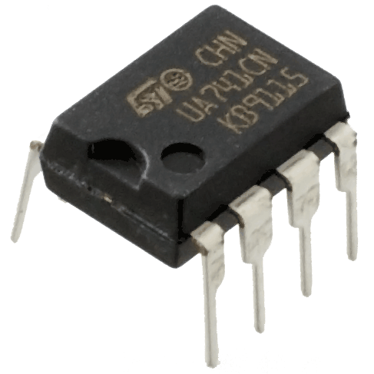
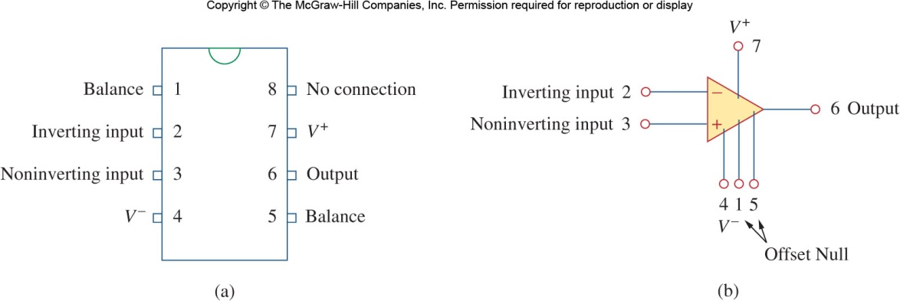
Op Amp Terminals
Five important terminals
  The inverting input
  The noninverting input
  The output
  The positive (+) power supply
  The negative (-) power supply
The rest three terminals
  2 Offset Null (Balance)
    May be used to compensate for performance degradation due to aging etc.
  1 No Connection (NC)
    Unused, not connected to the amplifier circuit.

Slide 5
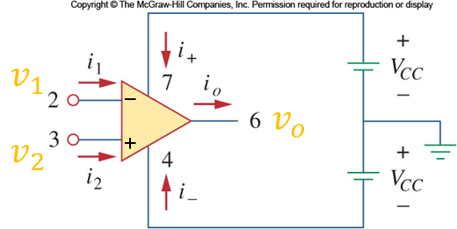


Output Voltage
The voltage output of an op-amp is proportional to the difference between the noninverting and inverting inputs
Op Amp in the real world
$$v_{o}=Ad\left(v_{2}−v_{1}\right)+Ac\left(v_{2}+v_{1}\right)/2$$
共模抑制比：$\frac{A_{d}}{A_{c}}$ or $20\log_{10}{\frac{A_{d}}{A_{c}}} (dB)$
Notes:
The above formula depends on the choice for 0 V point.

Slide 6
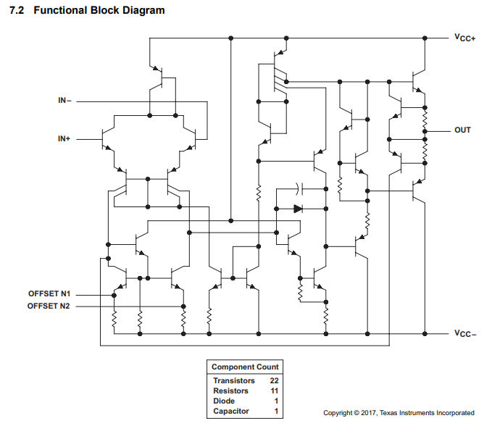
uA741 Functional Block Diagram

Slide 7
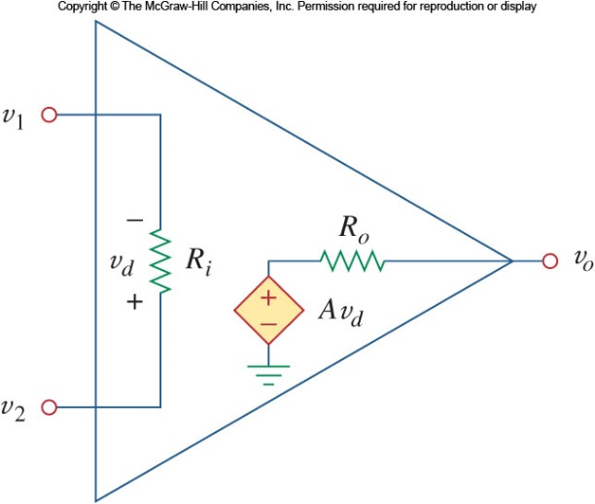
Equivalent Circuit of an Op Amp
Vcc+
V_{i-}
V_{o}
V_{i+}
Vcc-
The total current into the three terminals（V_{i+}, V_{i-}, and V_{o}) of an amp is nonzero.
KCL can still be applied to each node, but not to the model circuit as a whole (the red box) because Vcc+ and Vcc- are not part of the model circuit.

Slide 8
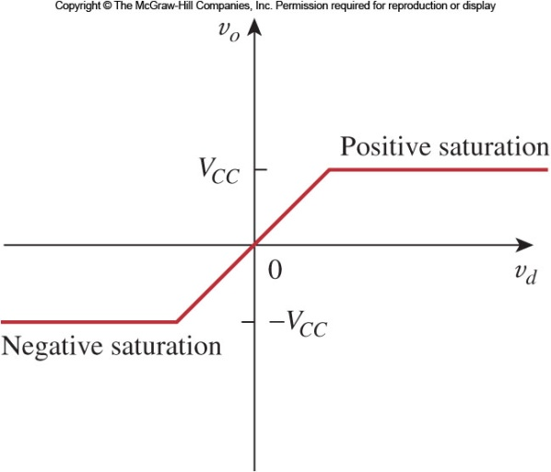
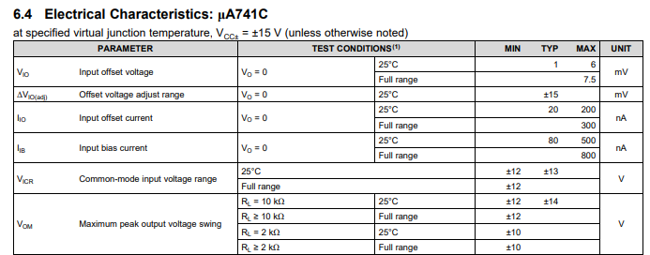
Voltage Saturation
Is the output voltage unlimited?
Notes:
How do we know the op-amp is operating in linear region?

Slide 9

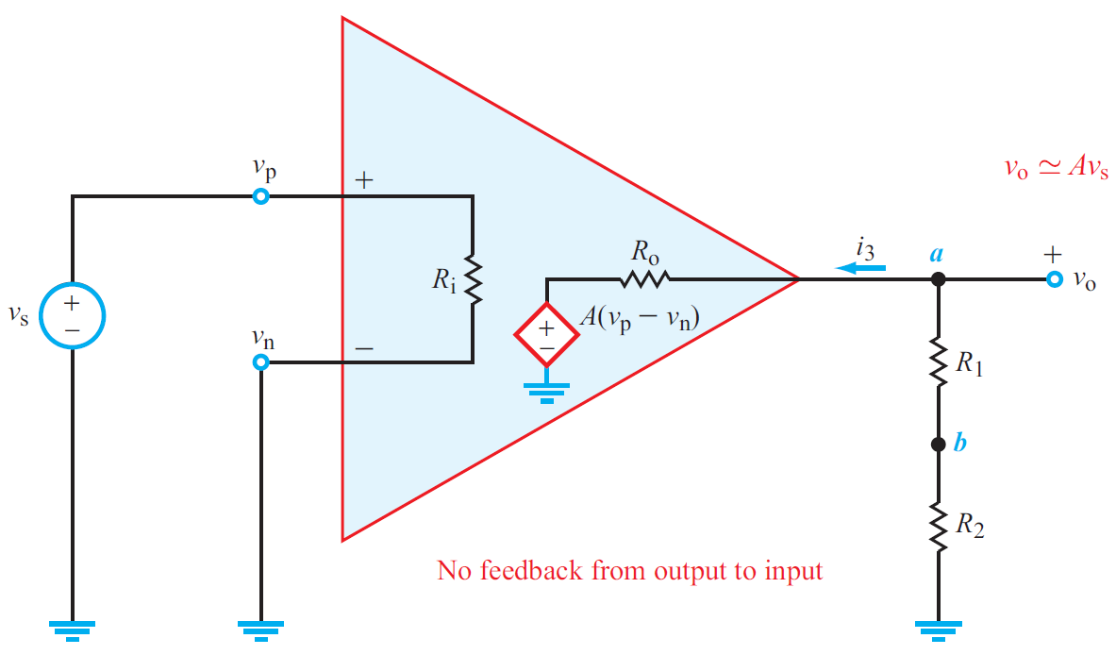
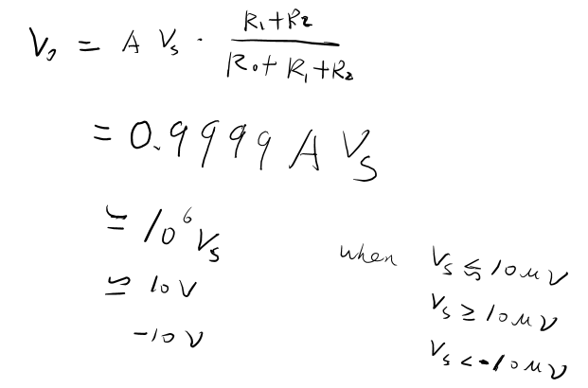

Example 1
find v_{o}, assuming the output
voltage range is $[−V_{cc}, V_{cc}]$.
假设输出电压的工作范围为

Slide 10
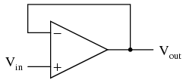
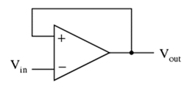
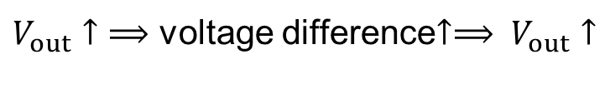
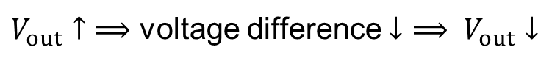
Feedback
Negative feedback
Positive feedback
$V_{out}↑$ $⟹$ voltage difference $↓$ $⟹ V_{out}↓$
$V_{out}↑$ $⟹$ voltage difference$↑⟹ V_{out}↑$
负反馈：当输出端电压变化通过外部电路反馈至输入端时，反馈信号引起的输出端电压变化方向与原变化方向相反且通常幅度更大,从而能抵消输出电压的变化，维持输出电压稳定。
正反馈：当输出端电压变化通过外部电路反馈至输入端时，反馈信号引起的输出端电压变化方向与原变化方向相同,从而加剧输出电压的变化。
Notes:
https://en.wikipedia.org/wiki/Negative_feedback_amplifier

Slide 11
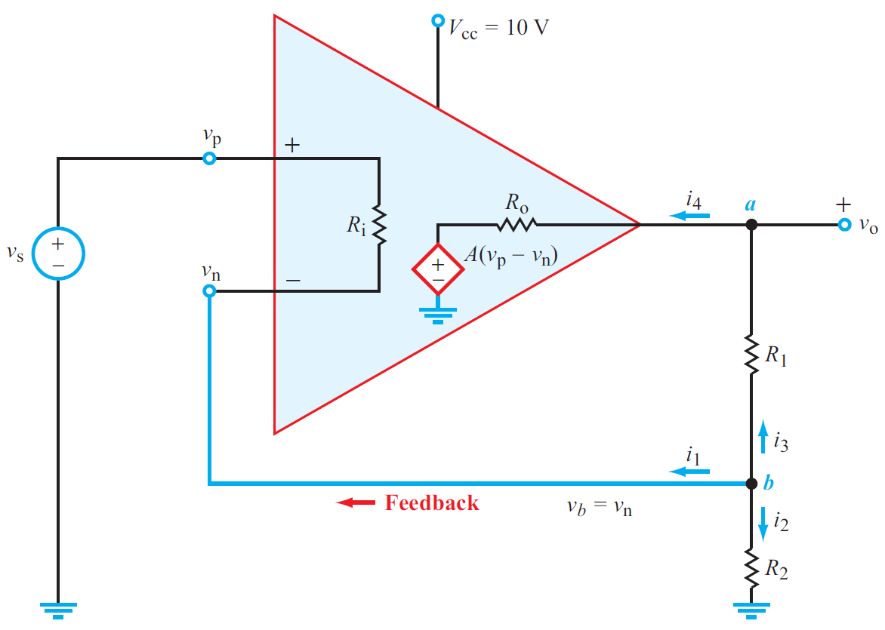
Example 2
Find v_{o} / v_{s}

Slide 12
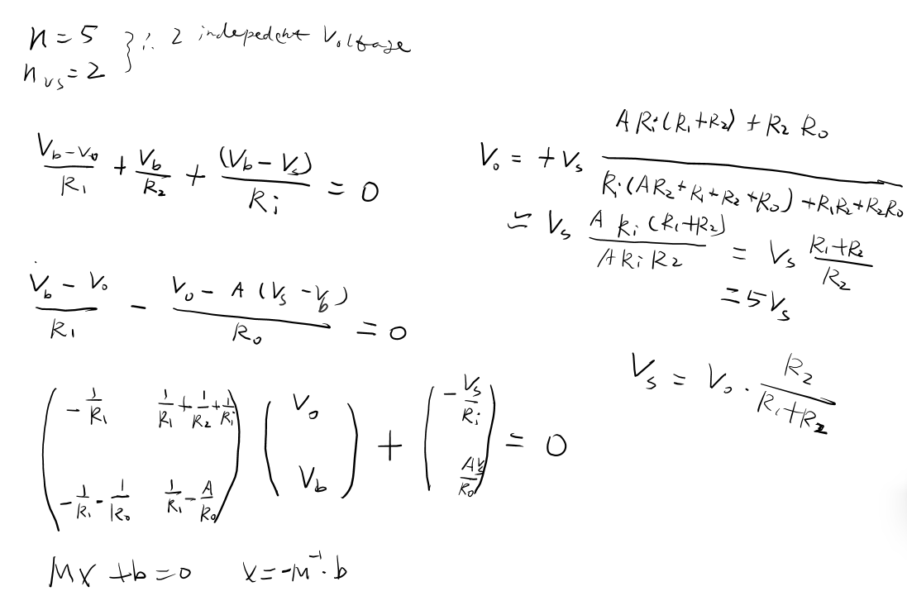

Example 2 (solution)
注意：当$A=−{10}^{6}$时（正反馈），同样可以得到$V_{s}≈V_{0}\frac{R_{2}}{R_{1}+R_{2}}$，但此时电压不稳定。

Slide 13
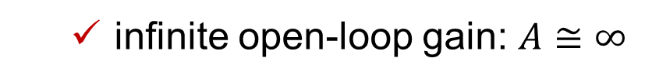
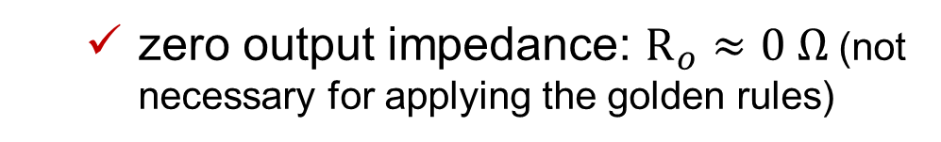
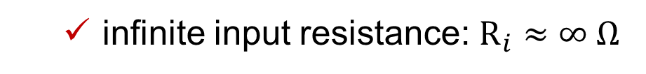
Attributes of an Ideal Op Amp
  infinite input resistance: $R_{i}≈∞ Ω$
  infinite open-loop gain: $A≅∞$
  zero output impedance: $R_{o}≈0 Ω$ (not necessary for applying the golden rules)

Slide 14
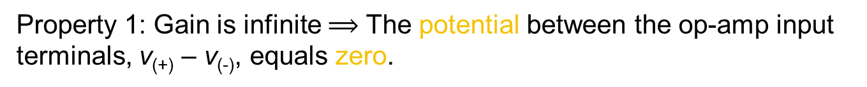

Ideal Op-Amp Analysis
When there exists negative feedback,
Property 1: Gain is infinite $⟹$ The potential between the op-amp input terminals, v₍₊₎ – v₍₋₎, equals zero.
Property 2: Input resistance is infinite $⟹$ The currents flowing into the op-amp’s two input terminals both equal zero.
No Potential Difference
No Currents
R₁
R₂
−
+
V₀
V_{IN}
Property 1 introduces an additional equation which replaces the KCL equation at the output node.

Slide 15
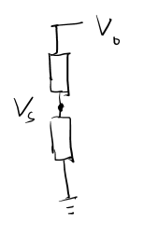

Example 3
Find v_{o} / v_{s}
Equivalent circuit
R₁
R₂
Note： there is no involvement of R₀ in the analysis.

Slide 16
Outline
Operational amplifier (op amp)
Basic operations
    sign changing
    amplification/scaling
    addition/subtraction
    integration
    differentiation
    analog filtering
DAC
Instrumentation amplifier

Slide 17
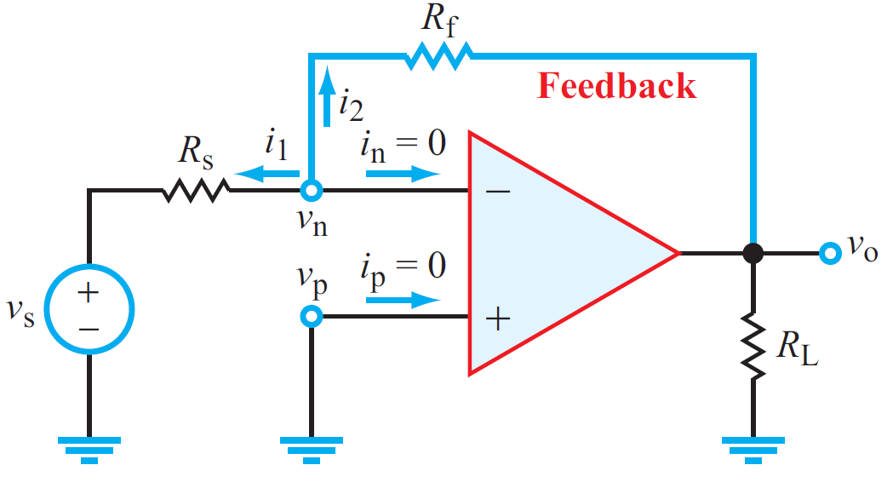
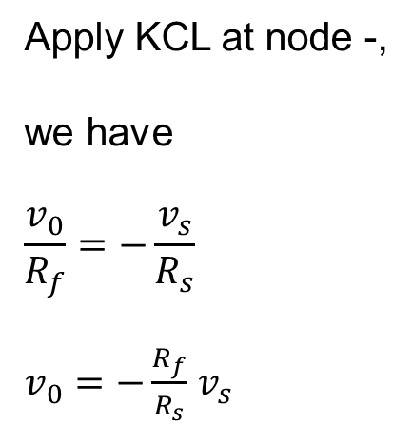
Inverting Amplifier
Apply KCL at node -,
we have
$$\frac{v_{0}}{R_{f}}=−\frac{v_{s}}{R_{s}}$$
$v_{0}=−\frac{R_{f}}{R_{s}}$ $v_{s}$

Slide 18
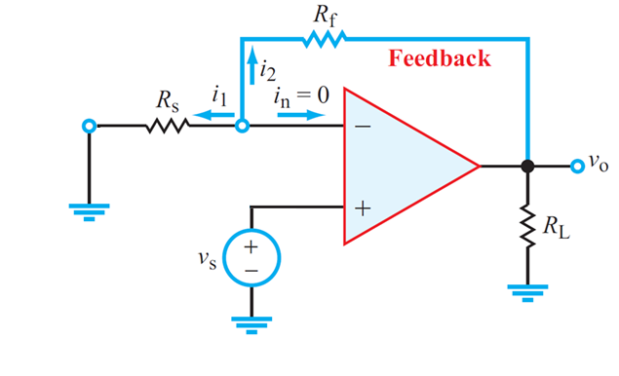
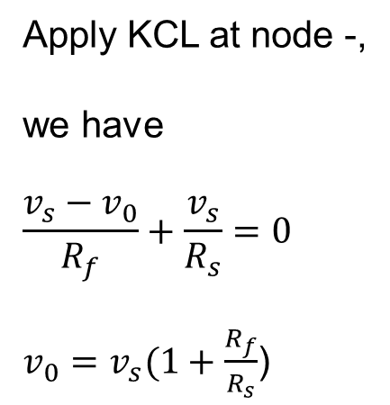
Non-inverting Amplifier
Apply KCL at node -,
we have
$$\frac{v_{s}−v_{0}}{R_{f}}+\frac{v_{s}}{R_{s}}=0$$
$v_{0}=v_{s}(1+\frac{R_{f}}{R_{s}}$)
When $R_{f}=0$ and $R_{s}=∞$, we get $v_{0}=v_{s}$, i.e. a voltage follower.

Slide 19
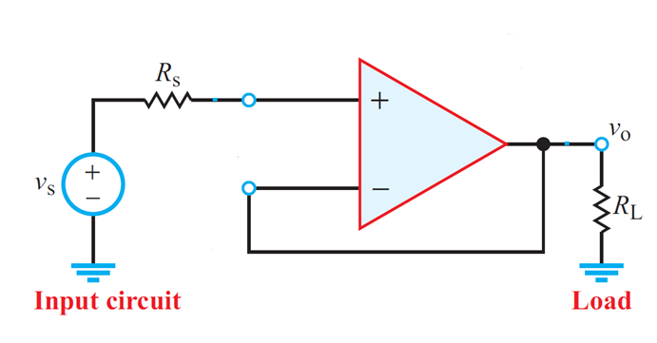
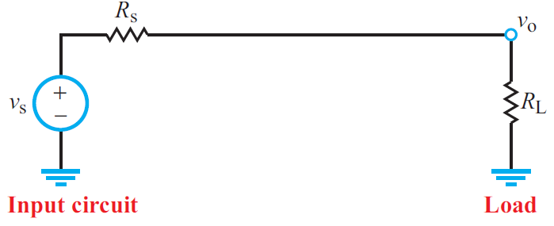
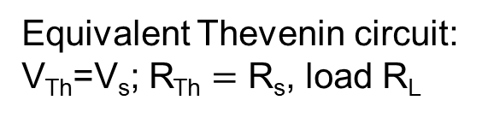
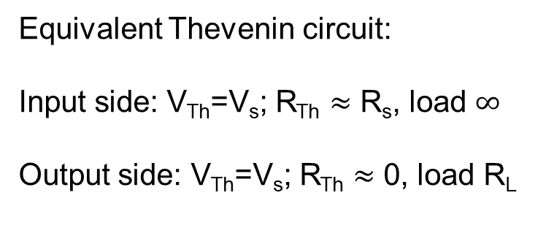
Application: Voltage Follower
Voltage follower
Direct connection
Equivalent Thevenin circuit:
Input side: V_{Th}=V_{s}; R_{Th} $≈$ R_{s}, load $∞$
Output side: V_{Th}=V_{s}; R_{Th} $≈$ 0, load R_{L}
Equivalent Thevenin circuit: V_{Th}=V_{s}; R_{Th} $=$ R_{s}, load R_{L}

Slide 20
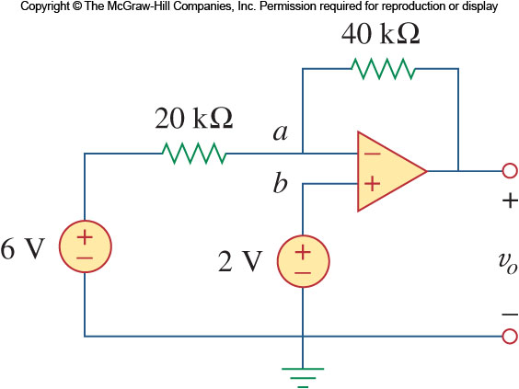

Practice 1
Determine $v_{o}$ in the circuit shown below
Answer: (V₀-2)/40=-4/20; V₀ = -6 V;

Slide 21
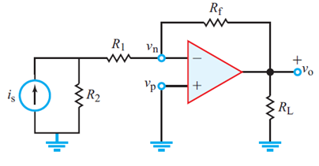

Practice 2
Determine $v_{o}$ in the circuit shown below.
V₀/R_{f}=-[(i_{s}*R₂)/(R₁+R₂)]
右边[..]内可理解为：
并联电路分流或
电源等效变换后串联电路的电流

Slide 22
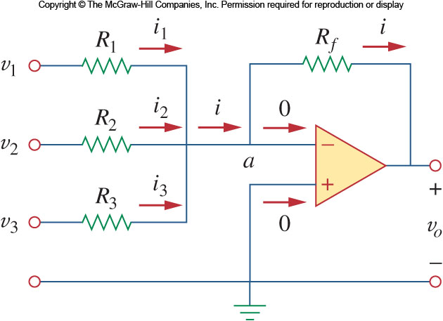
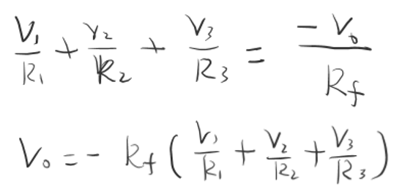
Summing Amplifier
Aside from amplification, the op-amp can be made to do addition readily.

Slide 23
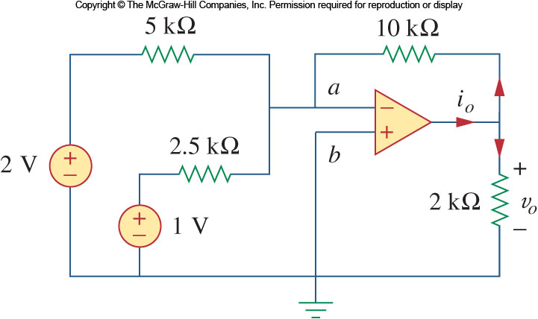

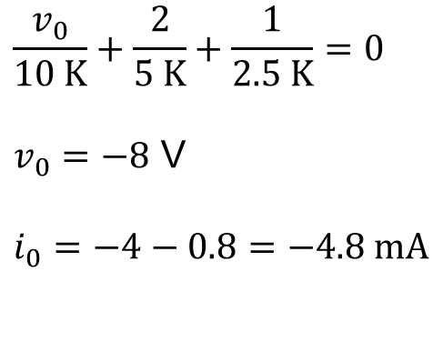
Practice
Find $v_{o}$ and $i_{o}$ in the circuit shown below
$$\frac{v_{0}}{10 K}+\frac{2}{5 K}+\frac{1}{2.5 K}=0$$
$v_{0}=−8$ V
$$i_{0}=−4−0.8=−4.8 mA$$

Slide 24
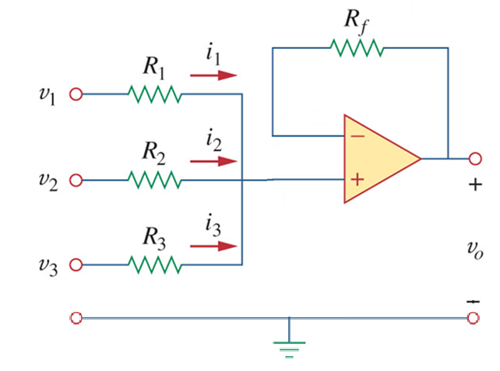
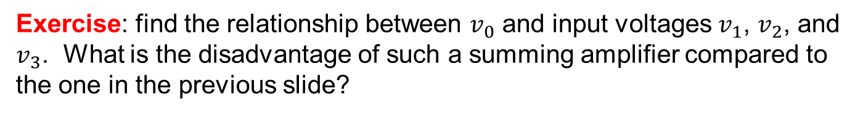
Exercise: find the relationship between $v_{0}$ and input voltages $v_{1}$, $v_{2}$, and $v_{3}$. What is the disadvantage of such a summing amplifier compared to the one in the previous slide?

Slide 25
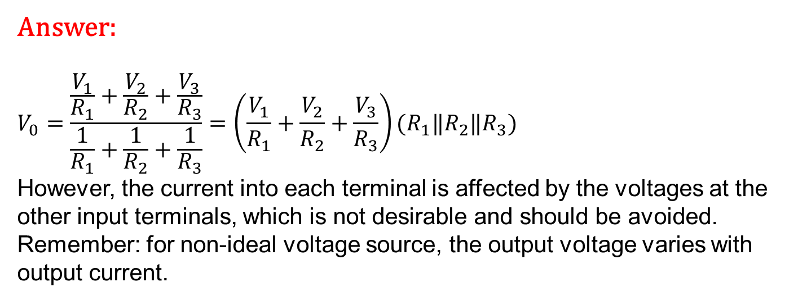
Answer:
$$V_{0}=\frac{\frac{V_{1}}{R_{1}}+\frac{V_{2}}{R_{2}}+\frac{V_{3}}{R_{3}}}{\frac{1}{R_{1}}+\frac{1}{R_{2}}+\frac{1}{R_{3}}}=\left(\frac{V_{1}}{R_{1}}+\frac{V_{2}}{R_{2}}+\frac{V_{3}}{R_{3}}\right)(R_{1}‖R_{2}‖R_{3})$$
However, the current into each terminal is affected by the voltages at the other input terminals, which is not desirable and should be avoided. Remember: for non-ideal voltage source, the output voltage varies with output current.

Slide 26
Ideal Op-Amp Analysis
When there exists negative feedback,
Property 1: Gain is infinite $⟹$ The potential between the op-amp input terminals, v₍₊₎ – v₍₋₎, equals zero.
Property 2: Input resistance is infinite $⟹$ The currents flowing into the op-amp’s two input terminals both equal zero.
No Potential Difference
No Currents
R₁
R₂
−
+
V₀
V_{IN}
Property 1 reduces the number of unknown voltages by 1 which compensates the lack of KCL equation at the output node.

Slide 27
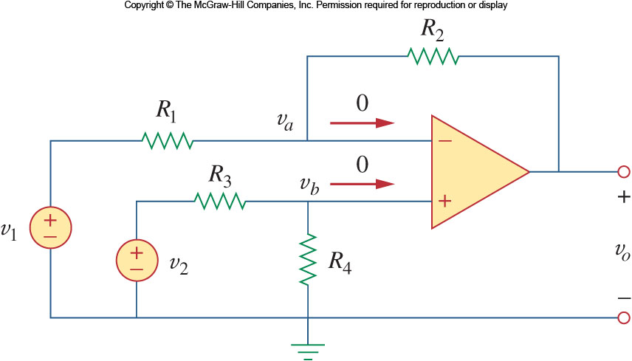
Difference Amplifier

Slide 28
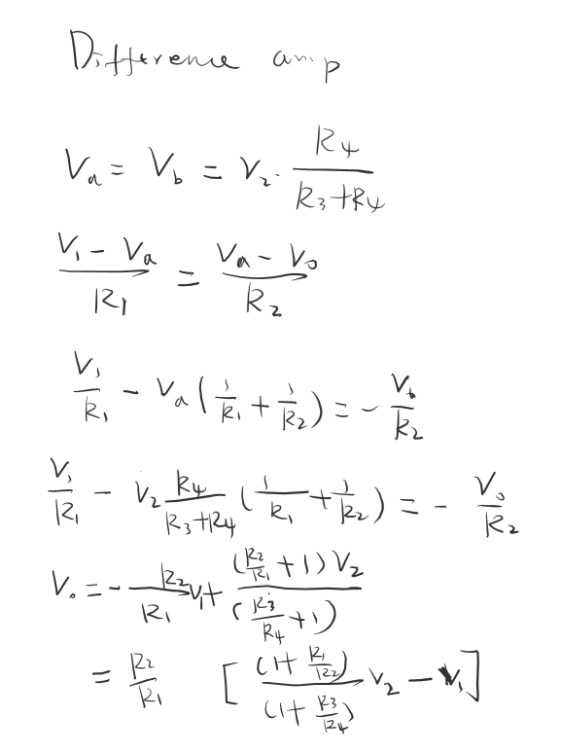

Difference Amplifier (solution)
Note: current from voltage source 1 is affected by $v_{2}$, but not the other way around.

Slide 29
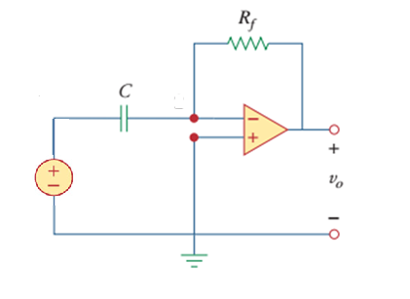





Differentiator
Find the relationship between $v_{o}$ and $v_{i}$ in the circuit shown below
$$i$$
$$v_{0}=−R_{f}i=−R_{f}C\frac{dv_{i}}{dt}$$
$$v_{i}$$
$$i$$
For this equation to be valid, the response time of the op-amp must be much shorter than $R_{f}C$.

Slide 30
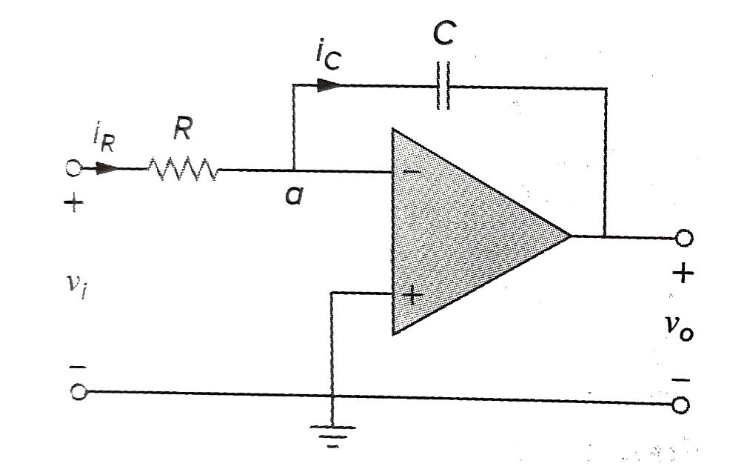
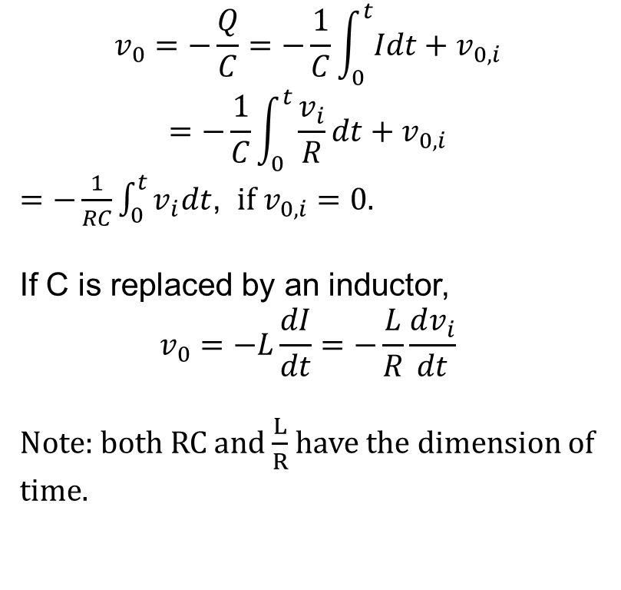

Integrator
Find the relationship between $v_{o}$ and $v_{i}$ in the circuit shown below. What if the capacitor is replaced by a inductor?
+
-
$$v_{0}=−\frac{Q}{C}=−\frac{1}{C}\int_{0}^{t}{Idt}+v_{0,i}$$
$$=−\frac{1}{C}\int_{0}^{t}{\frac{v_{i}}{R}dt}+v_{0,i}$$
$=−\frac{1}{RC}\int_{0}^{t}{v_{i}dt}$, $if{ v}_{0,i}=0.$
If C is replaced by an inductor,
$$v_{0}=−L\frac{dI}{dt}=−\frac{L}{R}\frac{dv_{i}}{dt}$$
Note: both RC and $\frac{L}{R}$ have the dimension of time.

Slide 31
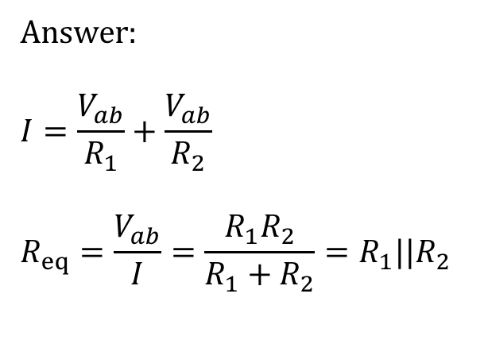
Practice 3
Determine the equivalent resistance at terminals a-b.
Answer:
$$I=\frac{V_{ab}}{R_{1}}+\frac{V_{ab}}{R_{2}}$$
$$R_{eq}=\frac{V_{ab}}{I}=\frac{R_{1}R_{2}}{R_{1}+R_{2}}=R_{1}{||R}_{2}$$
a
b

Slide 32
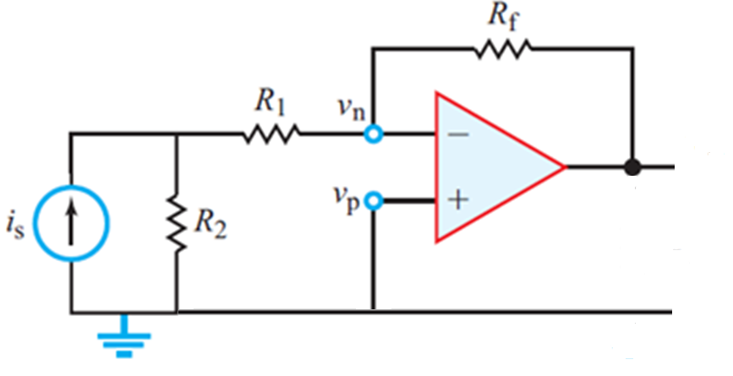
Practice 4
Determine the Thevenin’s equivalent resistance at terminals a-b.
a
b

Slide 33
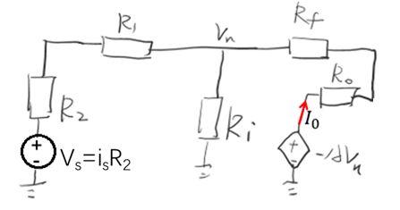
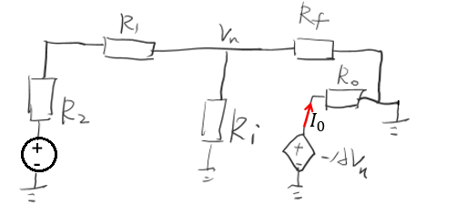
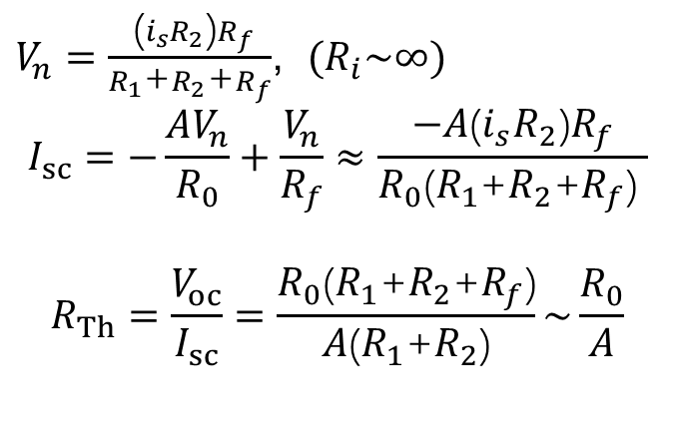



Practice 4 (solution)
Open circuit
From ideal op-amp approximation, we have $V_{oc}=\frac{−i_{s}R_{2}R_{f}}{ R_{1}\text{+}R_{2} }$
$$V_{oc}$$
Short circuit
$V_{n}=\frac{ \text{(}i_{s}R_{2}\text{)}R_{f}}{R_{1}\text{+}R_{2}\text{+}R_{f}}$, $(R_{i}\sim ∞)$
$$I_{sc}=−\frac{AV_{n}}{R_{0}}+\frac{V_{n}}{R_{f}}≈\frac{−A\text{(}i_{s}R_{2}\text{)}R_{f}}{R_{0}\text{(}R_{1}\text{+}R_{2}\text{+}R_{f}\text{)} }$$
$$R_{Th}=\frac{V_{oc}}{I_{sc}}=\frac{R_{0}\text{(}R_{1}\text{+}R_{2}\text{+}R_{f}\text{)}}{A\text{(}R_{1}\text{+}R_{2}\text{)}}\sim \frac{R_{0}}{A}$$
$$I_{sc}$$
V_{s}=i_{s}R₂

Slide 34
Application - DAC
8
7
6
5
Analog Output (V)
4
3
2
1
0
0
2
4
8
14
16
1
The voltage levels are discrete
It is proportional to the digital value
Approximately continuous if the step is small enough
Digital Input

Slide 35
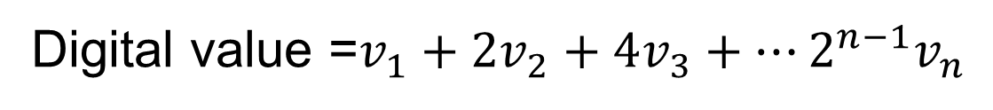

Binary representation
$\left[v_{n}……v_{3}v_{2}v_{1}\right]$, $v_{i}=0$or 1.
MSB
LSB
Digital value =$v_{1}+2v_{2}+4v_{3}+…2^{n−1}v_{n}$

Slide 36


DAC
$−V_{o}=\frac{R_{f}}{R_{1}}V_{1}+\frac{R_{f}}{R_{2}}V_{2}+\frac{R_{f}}{R_{3}}V_{3}+\frac{R_{f}}{R_{4}}V_{4}=\frac{R_{f}}{R_{1}}（V_{1}+\frac{R_{1}}{R_{2}}V_{2}+\frac{R_{1}}{R_{3}}V_{3}+\frac{R_{1}}{R_{4}}V_{4}$）
If$\frac{R_{1}}{R_{2}}=2，$ $\frac{R_{1}}{R_{3}}=4$， $\frac{R_{1}}{R_{4}}=8$， then $V_{o}$=$−\frac{R_{f}}{R_{1}}（V_{1}+2V_{2}+4V_{3}+8V_{4}$）
二进制数字的值

Slide 37

DAC
“Weighted-adder D/A converter”
S₄
10K
20K
S₃
40K
5K
8V
₊ ₋
S₂
80K
−
−
+
V₀
+
S₁
4-Bit D/A
(Transistors are used as electronic switches)
$$V_{i}=−8S_{i}$$
$V_{o}$=$−\frac{R_{f}}{R_{1}}（V_{1}+2V_{2}+4V_{3}+8V_{4}）=0.5(S_{1}+2S_{2}+4S_{3}+8S_{4})$

Slide 38
Instrumentation Amplifier
The amplification factor controllable and not too large to allow a sufficient dynamic range. → multiple resistance options.
The input signal often has an unknown offset → differential amplifier.
The Thevinen resistance of the input signal is not negligible. → two stage design.

Slide 39






Instrumentation Amplifier
Ad8231
V_{i-}
V₁
R₁
$$V_{o}$$
R₂
V_{i+}
R₃
V₂
The circuit can be separated into 2 stages
Stage 1: $(V_{i+}−V_{i−})=(V_{2}−V_{1})\frac{R_{2}}{R_{1}+R_{2}+R_{3}}$
Stage 2: $V_{o}=(V_{2}−V_{1})$

Slide 40

Instrumentation Amplifier (practice 5)
下图为某仪表放大器的内部电路图，如果将端口12与3相连，端口9与10相连，端口6接地。求 OUTPUT(端口9)的电压与“+input”(端口2)- “-input” (端口1)间电压差的关系。
V₁
V₂

Slide 41

practice 5 solution
V_{output}=V₂-V₁
V_{+input}-V_{-input}
=(V₂-V₁)$\frac{R_{3,16}}{40000+R_{3,16}}$
V_{output}=(V_{+input}-V_{-input})$\left(1+\frac{40000}{R_{3,16}}\right)$
$$R_{3,16}=80.2+\frac{124∙(\text{225.3+4445.7})}{124+\text{225.3+4445.7 }}=200.99$$
V_{output}=200(V_{+input}-V_{-input})

